Slide 1
Installation Guide
AITSP: AI powered Tech Support Platform
VIT_VELLORE_DEVTOS
Shivam Kumar Pandey
Sourav Dey
Credentials at the last slide

Slide 2
1. Flask Application
Platform: AWS Elastic Beanstalk
Follow the instructions given here:
https://docs.aws.amazon.com/elasticbeanstalk/latest/dg/create-deploy-python-flask.html
Use 1answer-phone.py as the flask application and deploy your EB repository
Use the “/record” path along with the link provided to access your application in the EB environment as webhook.

Slide 3
2. Changing the webhook
Platform: Twilio
Go to Menu->Phone Numbers->Active Numbers
Select the number you want to use
Change the webhook with the Flask App link provided by Elastic Beanstalk (Add “/record” to path)
Click “Save” at the bottom of screen
Refer:
https://www.twilio.com/docs/voice/tutorials/how-to-respond-to-incoming-phone-calls-python

Slide 4
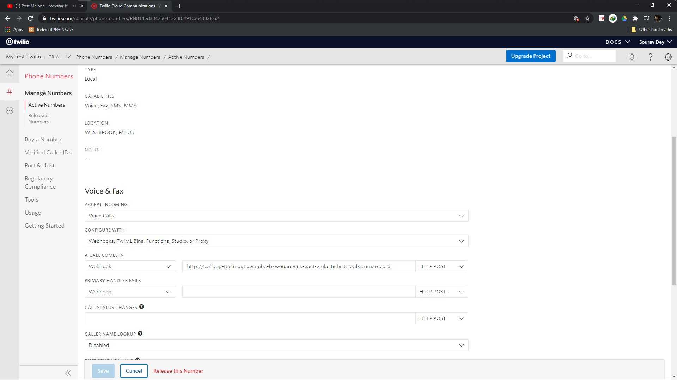
2. Changing the webhook
1
2

Slide 5
3. Deploying remaining scripts on a VM
Platform: AWS
Deploy a new EC2 instance by following the given steps:
https://aws.amazon.com/getting-started/tutorials/deploy-code-vm/
On the new VM (preferably Linux), use vi editor to easily and quickly create the remaining scripts on this machine.
Install Python 3 (or 3.7) to your VM
Install “requirements.txt” using sudo and pip
(You might need to install some missing libraries to your VM)

Slide 6
4. Run the scripts
Platform: AWS
Login to your system
Run “runner.py” using admin privileges
The generated files will be present in their respective folders.

Slide 7
Example
Personal system: Windows
VM: Amazon Linux – 2 (Default EC2 instance OS)
SSH using PuTTY

Slide 8
Connect via PuTTY or SSH
Launch PuTTy
Enter your machine’s public IP in host name field (ec2-18-216-238-173.us-east-2.compute.amazonaws.com for our machine)
In left side section: category->Connection->SSH->Auth
In the private key field, navigate to .ppk provided (Or the key generated for your machine’s security group).
Come back to session and click Open

Slide 9
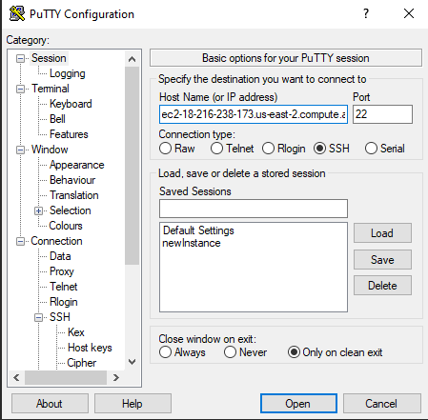
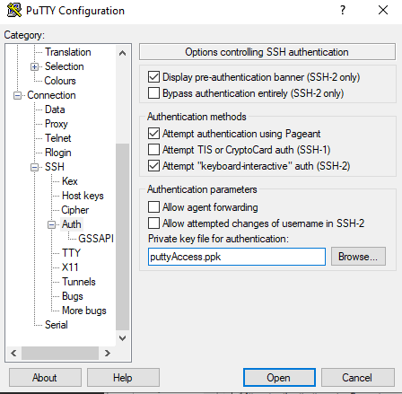
1. 2.
5.
3.
4.

Slide 10
Connecting and Running
Login to your VM with preset credentials (default: ec2-user)
Install Python(3.7) and other dependencies that may arise in next step
Install “requirements.txt” (sudo pip install –r requirements.txt)
Run “runner.py” (sudo python3 runner.py )

Slide 11
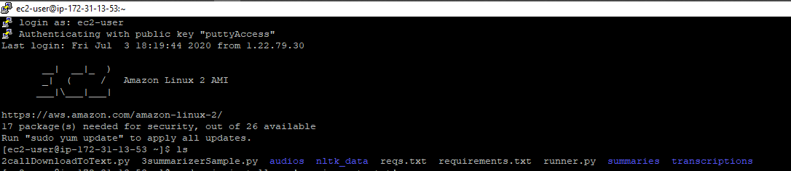
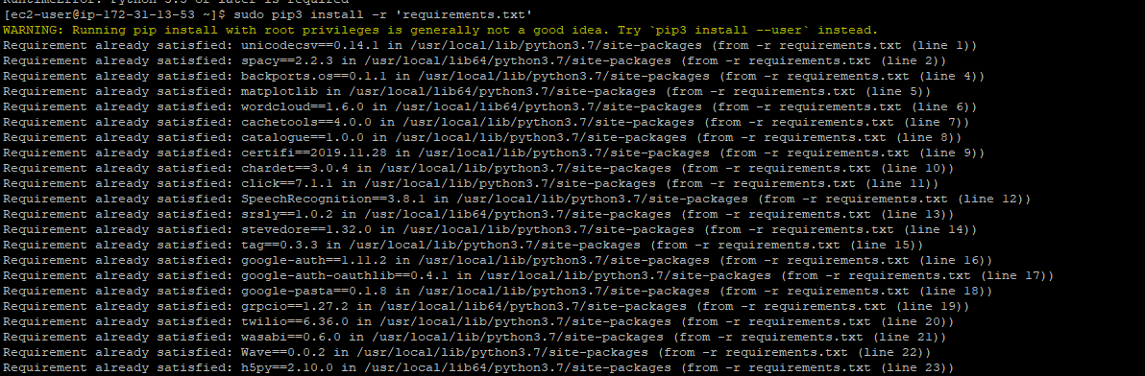
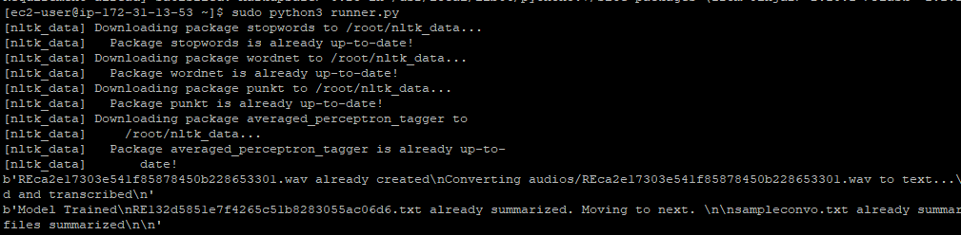
Logging In:
Installing Requirements:
Running Script:

Slide 12
Understanding the output
The generated output belongs to individual modules running automatically every 5 seconds until interrupted.
No files are re-downloaded and each file has a unique name in each folder.
The summaries folder contains a .csv and a .txt file with same names
These correspond to individual’s data(like names, email, phone number and dates), and their call’s text summary respectively.

